Slide 1


National
Education
Cycle
MARKETING
&
COMMUNICATIONS

Slide 2
Introduction
Opening this booklet you have decided to learn something you couldn't
recieve in school or college. Is information, knowledge, processes to engage
in the largest youth organization in the world.
This functional area is the hub of functions, because we take part in every part of the organisation to make it grow, to make sustainable and to make it expand.
I hope the information in this booklet helps you to give you a perspective on things.
Enjoy the journey.
Opas Onucheyo
MCVP Marketing & Communications

Slide 3
Introduction…………………………………………….…2
Understanding the contribution of Marketing…….……...4
Communication……………………………………….……18
Product Education …………….…………………………..22
Branding & Organizational Understanding……………....26

Slide 4
Understanding the contribution of Marketing
What is Marketing?
Marketing is the process of communicating the value of a product to customers, for the purpose of selling that product or service.
The management process through which goods and services move from concept to the customer. It includes the coordination of four elements called the 4 P's of marketing:
(1) identification, selection and development of a product,
(2) determination of its price,
(3) selection of a distribution channel to reach the customer's place, and
(4) development and implementation of a promotional strategy.

Slide 5
Why Marketing is important?
Success
Getting Word Out
Higher Sales
Company Reputation
Healthy Competition
= Marketing

Slide 6
Why Marketing is important in AIESEC?
Marketing has a lot of contribution to all front(ICX and OGX) & back office(Marketing, Talent Management, Finance) functional areas in reaching students for recruitment, volunteer work and also for professional work. We are one of the reason we have grown so much in the past and are still growing.
HOW MARKETING CONTRIBUTES EXCHANGE &
TALENT MANGEMENT.
InComing eXchange(ICX).
Marketing contributes in various ways of helping this functional area have the right material to promote to target area countries. Passing the right message information the EP will need.
Outgoing Exchange(ogx).
Marketing has to provide the right attractive materials in the right way to give every person a reason to signup for this program.
Talent Management(TM).
Marketing has to look for the right places and right information to source for these people who will continue in the organization to make it more relevant in the society

Slide 7
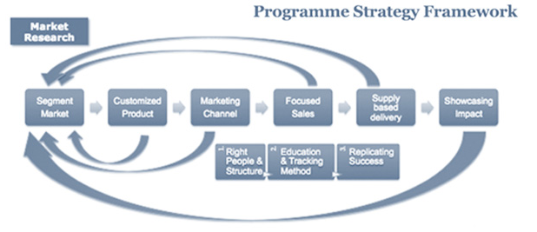


Slide 8
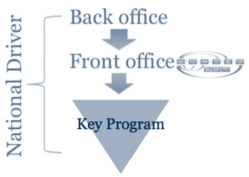

Slide 9



Our products
ogx-GCDP
ICX-GCDP
TM

Slide 10
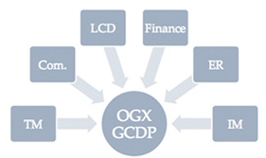
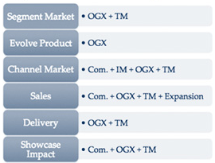
Can be implement for other focus programs

Slide 11
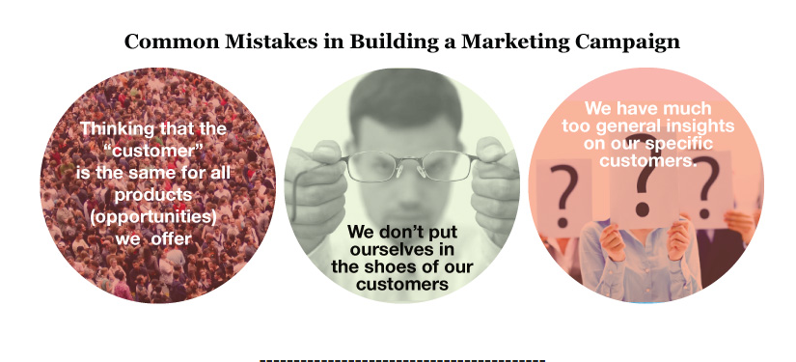

Slide 12
How we contribute
Marketing has alot of strategies to implment to a focus area and acheive growth.
As an organisation, we have focused on using two major modules to keep the organisation being at the right place at the right time.
We using the GTMC module and Product-customer flow
G-Goal
T-Target
audience
M-Message
C-Channel

Slide 13
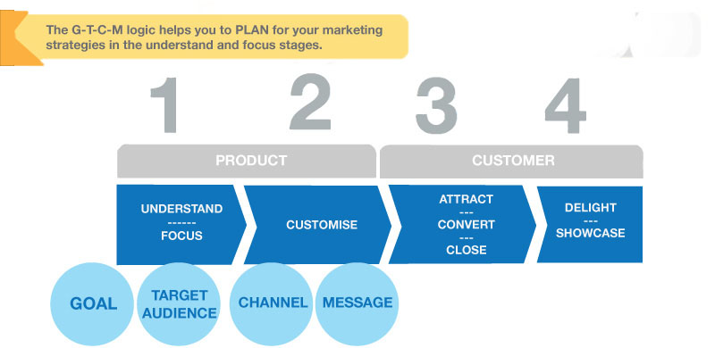
G.T.M.C- PRODUCT-Customer flow
This is the basic relation that can be found in marketing, in sourcing for potential people to engage with AIESEC

Slide 14

G :Determined from the focus areas should put focus on the decided drivers of the entity
eg: 1000 oGCDP Raised
T :Marketing plan should be customized towards specific target audience
Understand wants, needs, interests
C: Answers to the questions...
  Which channels’ do our Targets normally visit?
  How often do they go to these places?
  What do they do there?
Answers to these types of questions will help you clarify..
(1) Which Channel/ Places should you focus on for your promotions? and,
(2) When is the best timing for you to release your materials?
M: Main message - Tag line?
Customized message

Slide 15
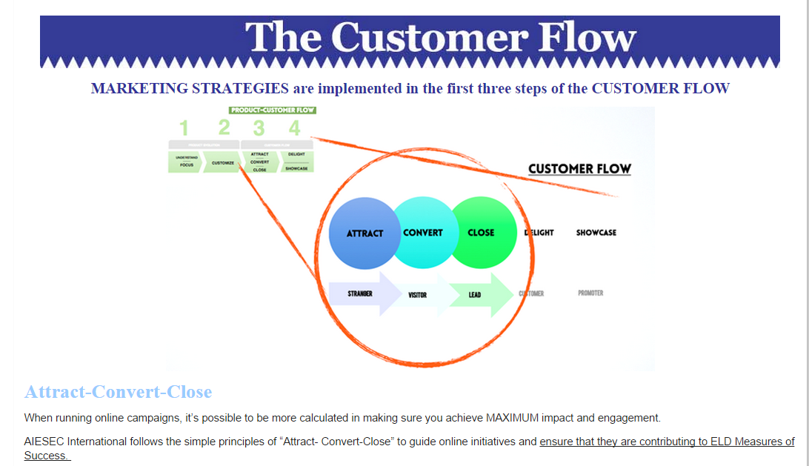

Slide 16


Refers to Building our reach and influence-- Engaging Strangers and turning them into "Visitors" that will be interested in us.
Driving user traffic to our online channels and building engagement within our platforms and communities.
We are not running online activities for the sake of running them and keeping in time with trends. All online content and physical activities aim to drive people to sign up to become a promoter or customer of AIESEC.
This includes follow up and management of our online and physical sign-ups in order to finally raise them as Members or EP's.
This means improving and optimizing your selection process from the first point of contact with your applicant.

Slide 17
Understand | Understanding internal and external reality based on historical data
Focus | Select Main Target Markets (based on Sub-Products for GIP/ Issues for GCDP)
Customize | Evolving product value and packaging based on this
Attract | Engaging target audience and positioning the product strategically across channels.
Close | Ensure that the people you engage are directed by a "Call to Action" towards signing up as a potential customer.
Convert | Now that you have people that have expressed interest (also known as "leads") then the task to to ensure that they are finally selected and Raised as a Customer (Member, EP or TN).
Delight | Once raised as a customer, there's a need to look into measures to ensure proper Customer Experience Management.
Showcase | Through out an AIESEC Experience, there are many stories and insights that are worth showcasing to the external environment that would help to attract more customers or promoters for AIESEC.

Slide 18

Communication
Communication is the heart of any organization. This takes place when both parties
understand the information that Is being passed from one person to the other.
A practically example can be: if the founders of the organization didn’t communicate their ideas ,you wouldn’t be reading this information right now.
Who needs these information
Why do they need this information
How can we communicate to them
Once the message has passed between two people, communication has taken place. In AIESEC we have two main focuses for communication: EXTERNAL & INTERNAL communication. Depending on the customer we are able to know:

Slide 19

Other forms include whatsapp, Instagram, Twitter etc

Slide 20

Other forms include Websites, word of mouth etc

Slide 21

Other forms include Google Ads, Facebook Advertising, social bakersetc

Slide 22
Product Education
Knowing the products of AIESEC makes it easier to understand. Understanding the flow and role marketing plays with the other functional areas is key to the success of impact we want to see in the world.
The involvement of marketing in all products is vital, because it is the first touch-point to customers.
Global Internship Program-GIP( Contain InComing GIP and Outgoing GIP)
Global Community Development Program-GCDP(Contains Incoming GCDP and Outgoing GCDP)
Talent Management -TM( Contain Team Member and Team leader )

Slide 23
TM CUSTOMER FLOW
Marketing Involvement
Marketing Involvement
Marketing Involvement

Slide 24
GIP CUSTOMER FLOW
Marketing Involvement
Marketing Involvement
Marketing Involvement

Slide 25
GCDP CUSTOMER FLOW
Marketing Involvement
Marketing Involvement
Marketing Involvement

Slide 26
Branding & Organizational Understanding
The key understanding of the flow of organizational is vital for the continual growth. All the products have a unique value preposition to all customer depending on which of the products is used.
The INNER and OUTER journey is unique to all our products and is the basis for the growth of our members.

Slide 27
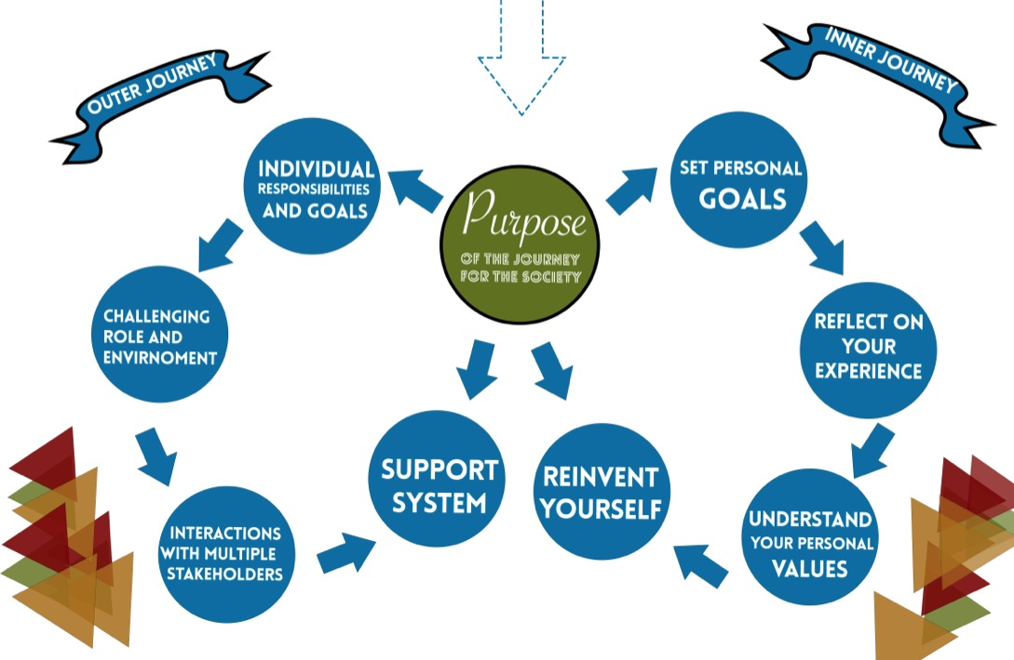

Slide 28

branding
Branding is the source of communication, where ideas or the concept of the idea is being transmit through a audio-visual .
Branding represents all of the organization values into a single piece of “Brand”. Every brand is unique to its company, it shows it value, its importance, its mission of the company.
Looking at the this logo ,you immediately can identify it with the technology company APPLE inc.
Our logo represent our brand, what we stand for our, the leadership we want to see in the youths of the world.

Slide 29
Our branding rules:
A I E S E C

Slide 30
DON’Ts
use the shapes to replace the AIESEC logo
use shapes in different proportions
DOs
use 2 or more different shapes
Use transparent or full colour shapes
always have an AIESEC “signature”
make individual shapes

Slide 31



Slide 33


Slide 34

An initiative of AIESEC
or
Powered by AIESEC
or

Slide 35
2 fonts you can use in your design:
Helvetica (regular, italic, bold, bold italic)
  abcdefghijklmnopqrstuvwxyz
  abcedfghijklmnnopqrstuvwxyz
  abcdefghijklmnopqrstuvwxyz
  abcdefghijklmnopqrstuvwxyz
Georgia (regular, italic, bold, bold italic)
  abcdefghijklmnopqrstuvwxyz
  abcdefghijklmnopqrstuvwxyz
  abcdefghijklmnopqrstuvwxyz
  abcdefghijklmnopqrstuvwxyz

Slide 36
An initiative of AIESEC
or
Powered by AIESEC
or

Slide 37


Examples/ Ideas
37

Slide 38

38

